Slide 1
Solid Principles II
Eric Furukawa, Austin Baccus

Slide 2
Presentation Planning
Principle, example, demo, ideal balance between examples and design smells
Cover I and D of SOLID
50 Minute Presentation -> 25 min slides, 25 min demo (Start 4:10, Demo 4:35)
I was thinking that I would present the section on Interface Segregation and we can spit the Recap/Demo
Practice Runthrough: Intro-End of ISP (12 Minutes no professor interruptions)
ISP Demo Explanation (4 Minutes w/o switching screens and work time IT 9 min)

Slide 3
Solid Principles I Recap

Slide 4
Recap
What are SOLID Principles?
-Five Principles developed by Robert C. Martin in 2000 (as a theory)
-General Rules
-Promote Readability, Flexibility and Maintainability (Deter Spaghetti)
-Part of Agile Development

Slide 5
Recap
S -> Single Responsibility Principle (A class should have one responsibility only)
O -> Open/Closed Principle (Software entities should be open for extensions but closed for modification)
L -> Liskov Substitution Principle (Type instances should be substitutable by instances of any of their subtypes)

Slide 6
Preface
-SOLID Principles can be difficult to understand w/o simplified wording and examples
-Some coding judgement is needed to determine when to use each SOLID principle to avoid the Contrived Complexity code smell!
-Now for the ID of SOLID

Slide 7
Interface Segregation Principle

Slide 8
Motivation
”Clients should not depend on methods they do not use” particularly in the context of implementing interfaces
We want readable, refactorable and maintainable class design
High Cohesion, Low Coupling

Slide 9
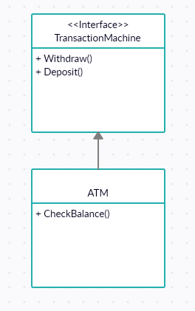
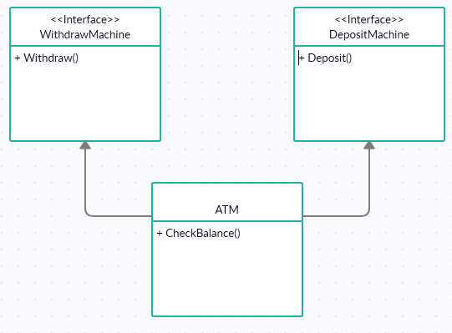
Paraphrasing, we should split up interfaces so that they contain only related methods/const fields

Slide 10
Code Smells
Large Classes: Classes will become very big and have functionality not required of them
Cause: Large coupled interfaces require classes to add unneeded functions
Needless Complexity: Code will become increasingly coupled and littered with empty functions
Cause: Interface pollution causes implementation of unneeded functions
Rigidity and Viscosity: Updates to an interface will require even unneeded functions to be updated
Cause: Interfaces are requiring classes to maintain unneeded functions

Slide 11
Use-Case
-Encountering previously mentioned code smells
-Large interfaces are constricting classes in code
-Interfaces/Classes contain unrelated functions

Slide 12
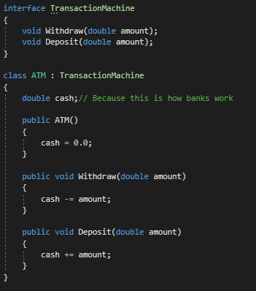
Examples
:(
The “Classic” ATM Example
Unnecessary Coupling of Withdraw and Deposit!

Slide 13
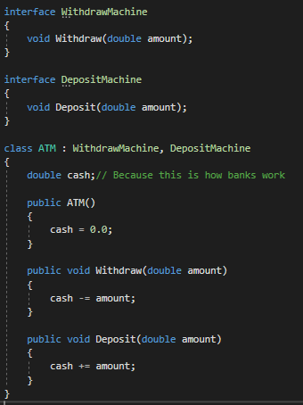
Examples
:)
Let’s Decouple Withdraw and Deposit!

Slide 14
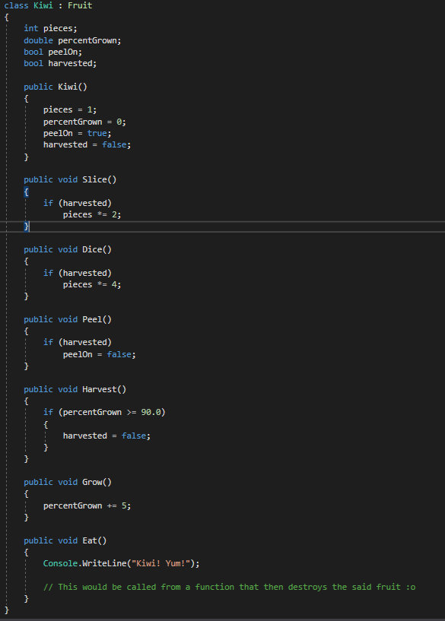
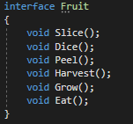
Examples
Kiwi Example
D:

Slide 15
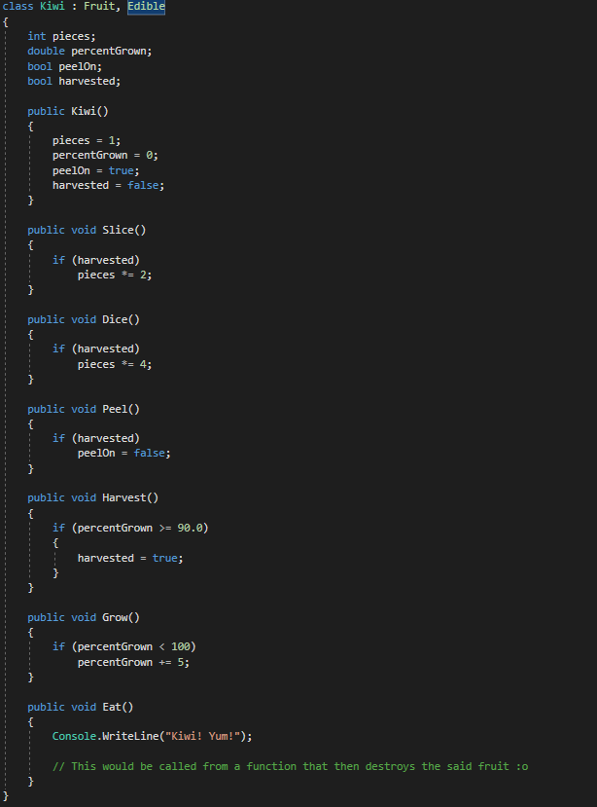
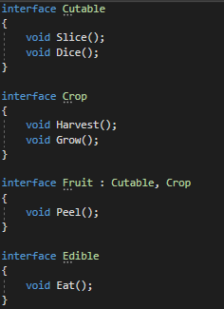
Examples
:)
?

Slide 16
Dependency Inversion Principle

Slide 17
Motivation
“High-level modules should not depend on low-level modules. Both should depend on abstractions.”
“Abstractions should not depend on details. Details should depend on abstractions”
Here, we want code to be not reliant on specific subtypes to allow for maintainability and flexibility; We’ll use Dependency Injection to avoid subtype dependency

Slide 18
Paraphrasing, we should use broader variables types of subtypes in implementations to allow for more code flexibility and updatability
Recall our lightswitch Command Demo, Command was a broad type, OnCommand was a specific type, Still we had arrays of Commands
We can ”inject” specific types using injection methods

Slide 19
Common Solution: Dependency Injection
-Add specific subtypes into the general variable containers within a method
-Such methods are called “Injectors”
-Can be a standalone method, included one with a larger purpose, a constructor, or just about any method

Slide 20
Code Smells
Rigidity and Viscosity: Code will be difficult to add functionality to or maintain
Cause: Strict dependencies on specific subtypes also restrict functionality of classes
Excessive, Similar Variables: Code may be littered with many variables containing different subtypes of a general type
Cause: Again, strict dependencies are requiring a different variable for every subtype needed

Slide 21
Use-Case
-Code is very dependent on many specific subtypes being used in other classes
-There are potential benefits in generalizing variables of subtypes to a broader parent type

Slide 22
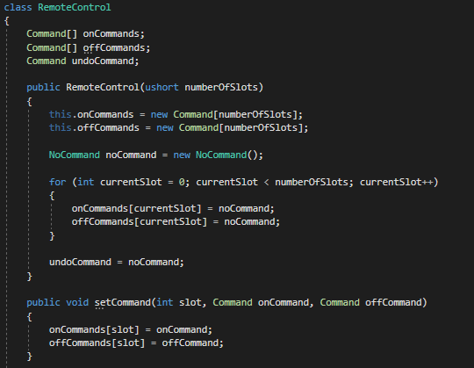
Example
LightSwitch Controller
From Week 9, Lecture 3

Slide 23
Code Demo

Slide 24
First: A Quick Anecdote : Solar System Demo

Slide 25
Let’s Use The Interface Segregation Principle
Assorted Tool Program
-Client should be able to create different tools and call use() on each
-So many unused functions!
-One massive interface
-Interface methods not very related
-Changes to interface requires tons of other changes

Slide 26
Demo Steps
FIRST:
-Split up the Tool interface into highly cohesive, lowly coupled interfaces
AND THEN:
-Create the PowerDrill and Microwave classes using the smaller interfaces
LASTLY:
-Create your own custom tool, preferably one that uses many interfaces (may require new interfaces!)
-Examples: Calculator, Sink, Microscope, Map

Slide 27
Let’s Use Dependency Injection for Dependency Inversion!
-Carnival Attendance Demo
-Make using class’s container broader!
-Then add Children and Senior attendees
-Then allow for the carnival to “InjectAttendees” (What is a better name?)
Side Note: There are many methods of using Dependency Injection!

Slide 28
References, Resources and Tools
Great explanations and examples for SOLID: https://itnext.io/solid-principles-explanation-and-examples-715b975dcad4
IS Principle Smells: https://ericbackhage.net/clean-code/solid-the-interface-segregation-principle/
DI Principle Smells: https://ericbackhage.net/clean-code/solid-the-dependency-inversion-principle/

Slide 29
Questions? Professor Comments?

